Slide 1
Enterprise Risk Management
Shareholder Value
Shad Higdon
Deloitte & Touche LLP
February 16, 2006

Slide 2
Agenda
Enterprise Risk Management History
Challenges With Enterprise Risk Management Today
Deloitte & Touche Point of View
Next Steps
Wrap-Up
Discussion

Slide 3
Enterprise Risk Management History
Maturing as a business process
1950s-1960s
Traditional Risk Management (“TRM”)
1970s
Risk management gains wider acceptance
1980s
Companies begin Risk departments, typically focused on insurance
1990s
Risk management matures as companies begin to focus on “business risk”
2004
Release of COSO ERM Integrated Framework
1950
1960
1970
1980
1990
2000
1977
Foreign Corrupt Practices
Act (“FCPA”)
Early 1980s
Increased focus on internal control and compliance
1985
National Commission on Fraudulent Financial Reporting — Treadway Commission
1992
Committee of Sponsoring Organizations (“COSO”) published Internal Control — Integrated Framework
2002
Sarbanes-Oxley Act of 2002
1990s-2000
Continued focus on internal control, risk management, and responsibilities
(Blue Ribbon Commission, Competency Framework for Internal Audit, others)
Enterprise Risk Management is intertwined with the development of internal control standards and the regulatory environment.

Slide 4
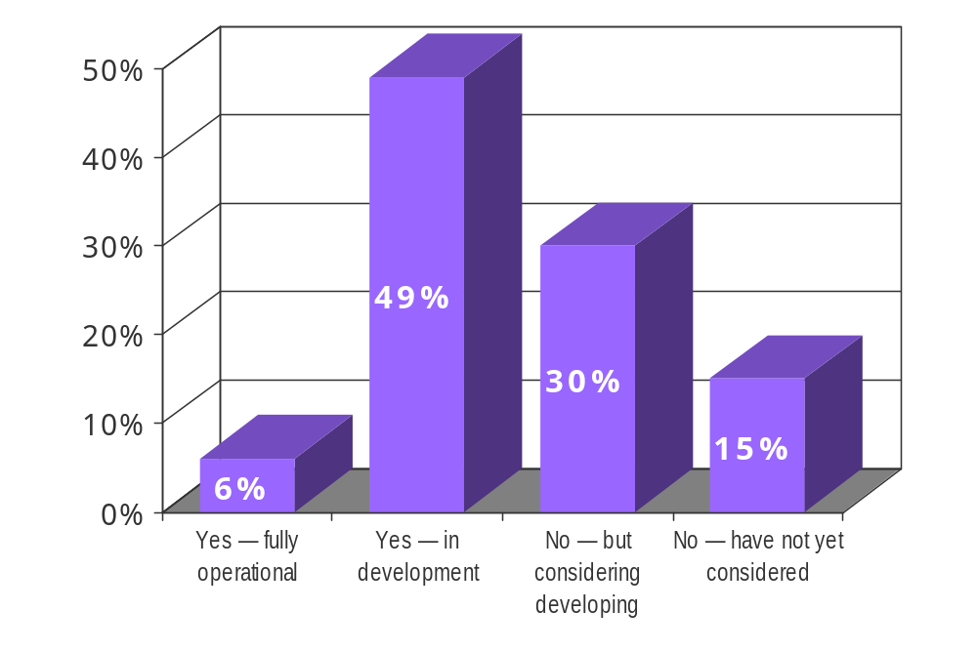
Enterprise Risk Management History/ Current State
Deloitte & Touche Observations
45% have no formal Enterprise Risk Management program
49% have a program in development
Still only 6% consider Enterprise Risk Management fully operational
Need to better define “fully operational” and “in development”

Slide 5
Enterprise Risk Management Defined
“a process, effected by an entity's board of directors, management and other personnel, applied in strategy setting and across the enterprise, designed to identify potential events that may affect the entity, and manage risks to be within its risk appetite, to provide reasonable assurance regarding the achievement of entity objectives.”
Source: COSO Enterprise Risk Management — Integrated Framework, 2004, COSO.

Slide 6
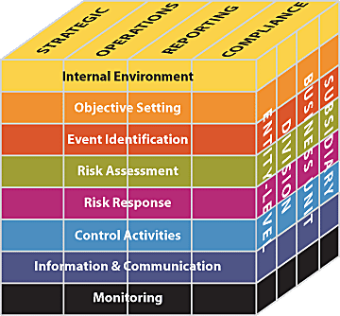
The Enterprise Risk Management Framework
The eight components
of the framework
are interrelated.
Source: COSO Enterprise Risk Management — Integrated Framework, 2004, COSO.

Slide 7
Enterprise Risk Management History/ Characteristics
Internal audit department-driven
Tactical response to specific risk or business concerns
Business/process objectives-based

Slide 8
Enterprise Risk Management History/
Typical Enterprise Risk Management Steps
Conduct executive interviews and/or surveys to gather management’s assessment of issues/risks
Compiling interview/survey results into quantitative valuation
Reporting to management via some type of executive dashboard
Not updated or monitored annually

Slide 9
Challenges With Enterprise Risk Management Today
Auditor vs. business partner:
  Internal audit-centric
  No business “value” connection
Complexity (lack of focus):
  Terminology/use of statistics
  Subjectivity and inconsistency
Objectives-based vs. value-based:
  Business unit
  Process
Highly fragmented approach to risk:
  Internal audit assessment
  Management’s opinion
  Insurance
  Marketing/credit

Slide 10


Deloitte & Touche
Point of View

Slide 11
Key Implementation Factors
Organizational design of business
Establishing an Enterprise Risk Management organization
Performing risk assessments
Determining overall risk appetite
Identifying risk responses
Communication of risk results
Monitoring
Oversight and periodic review by management
Source: COSO Enterprise Risk Management — Integrated Framework, 2004, COSO.

Slide 12
Shareholder Value
Revenue Growth
Operating Margin
Asset Efficiency
Expectations
Volume
Price
Realization
Selling,
General &
Administrative
(“SG&A”)
Cost of
Goods Sold
(“COGS”)
Income Taxes
Property, Plant
& Equipment
(“PP&E”)
Inventory
Receivables
& Payables
Company
Strengths
External
Factors
Acquire
New
Customers
Retain and
Grow
Current
Customers
Strengthen
Pricing
Improve
Customer
Interaction
Efficiency
Improve
Corporate/
Shared
Service
Efficiency
Improve
Development
& Production
Efficiency
Improve
Income Tax
Efficiency
Improve
PP&E
Efficiency
Improve
Inventory
Efficiency
Improve
Receivables
& Payables
Efficiency
Improve
Managerial
Effectiveness
Improve
Execution
Capabilities
Demand &
Supply
Management
IT, Telecom
&
Networking
Income Tax
Management
Governance
Leverage
Income-
Generating
Assets
Product
Development
Real Estate
&
Infrastructure
Finished
Goods
Product
& Service
Innovation
Real Estate
Improve
Logistics &
Service
Provision
Efficiency
Operational
Excellence
Price
Optimization
Materials
Accounts, Notes
& Interest
Receivable
Bus. Planning
Equipment
&
Systems
Human
Resources
Marketing
&
Sales
Cash/Asset
Management
Production
Logistics
&
Distribution
Accounts, Notes
& Interest
Payable
Marketing &
Advertising
Partnership
&
Collaboration
Product
& Service
Innovation
Procurement
(Excluding
Production Matl’s.
& Merchandise)
Merchandising
Sales
Program
Delivery
Relationship
Strength
Account
Management
Business
Management
Service
Delivery
Work in
Process & Raw
Materials
Agility &
Flexibility
Retention
Customer
Service &
Support
Financial
Management
Strategic
Assets
(People, Technology,
Relationships, etc.)
Cross-Sell/
Up-Sell
Order
Fulfillment
& Billing
Bus. Performance
Management
Copyright © 2005 Deloitte Development LLC. All rights reserved.

Slide 13
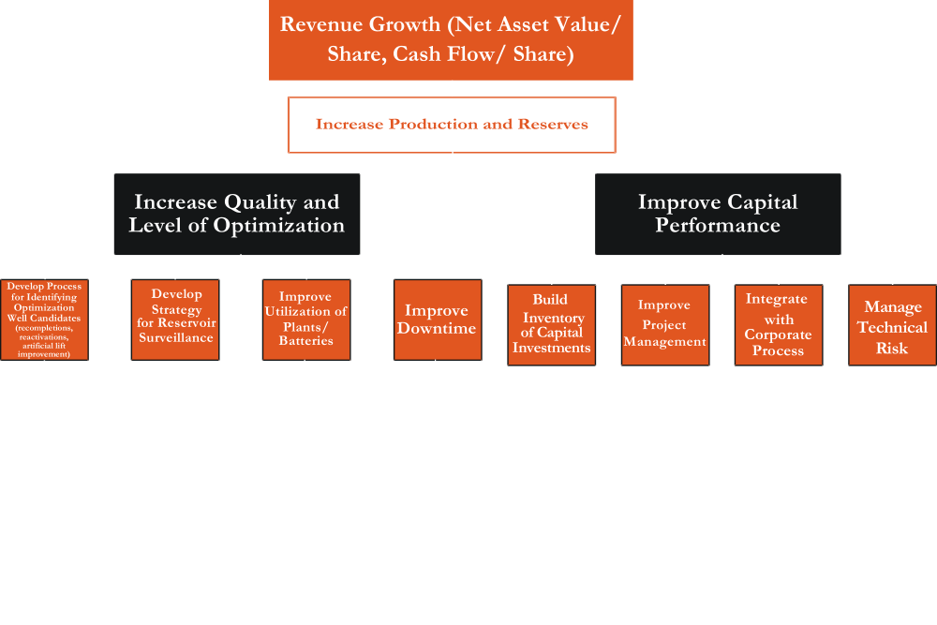
Upstream
Value Map
Copyright © 2005 Deloitte Development LLC.
All rights reserved.

Slide 14
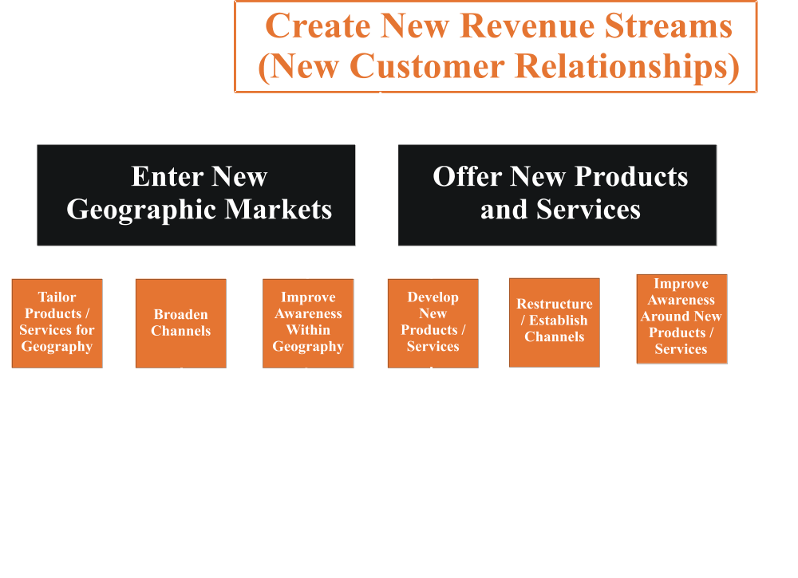
Downstream
Value Map

Slide 15
Advantages of Enterprise Risk Management Based on Shareholder Value
Direct linkage from risk management to shareholder value
Implements a process to emphasize shareholder value
Can be customized to the business
Consistent method of assessing and understanding risk
Consistent terminology by management, Internal Audit, and Risk departments
Multiple uses beyond risk management:
  Understand risk of investments
  Avoid inconsistent investments/business decisions
Addressing risk as an ongoing behavior, not a regularly scheduled process

Slide 16
Next Steps
How to take Enterprise Risk Management to the next level?
 | Owner of ERM | Auditor of ERM
Considering | Get executive sponsorship Identify roles and responsibilities of stakeholders and process owners
In Development | Understand the drivers of shareholder value Determine the risks of achieving those drivers Understand magnitude/impact of those risks Mitigate, monitor, or insure the risk Integrate the audit process | Participate in identification of drivers of shareholder value Integrate other audit processes into shareholder value perspective Access the validity of the drivers and risk identified in the program based on previous auditor activities
Fully Operational | Enhance your existing program by linking your objectives or risk directly with the values relevant to shareholders | You can validate the objectives of risk within the program to the values relevant to shareholders

Slide 17
Wrap-Up
Enterprise Risk Management is still maturing and gaining acceptance
Linkage to shareholder value creates the
opportunity to:
  Enhance effectiveness of existing Enterprise Risk Management programs
  Validate the current risk within an Enterprise Risk Management program
  Develop new Enterprise Risk Management programs with common language and objectives

Slide 18
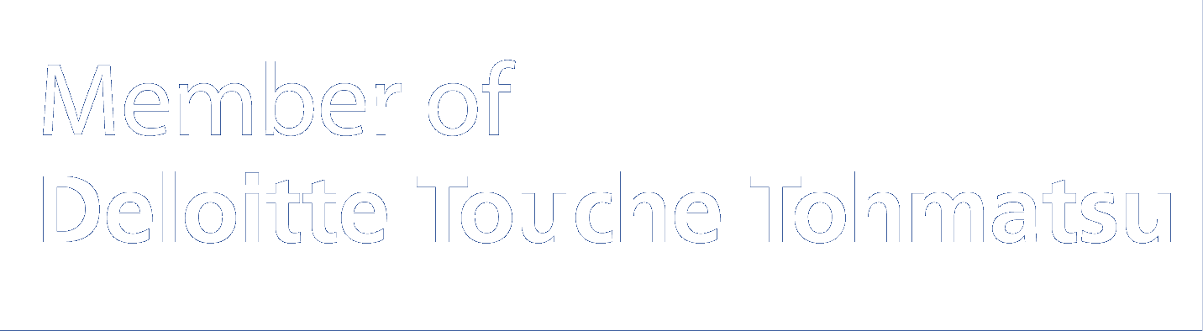
About Deloitte
Deloitte refers to one or more of Deloitte Touche Tohmatsu, a Swiss Verein, its member firms and their respective subsidiaries and affiliates. Deloitte Touche Tohmatsu is an organization of member firms around the world devoted to excellence in providing professional services and advice, focused on client service through a global strategy executed locally in nearly 150 countries. With access to the deep intellectual capital of 120,000 people worldwide, Deloitte delivers services in four professional areas, audit, tax, consulting and financial advisory services, and serves more than one-half of the world’s largest companies, as well as large national enterprises, public institutions, locally important clients, and successful, fast-growing global growth companies. Services are not provided by the Deloitte Touche Tohmatsu Verein and, for regulatory and other reasons, certain member firms do not provide services in all four professional areas.
As a Swiss Verein (association), neither Deloitte Touche Tohmatsu nor any of its member firms has any liability for each other’s acts or omissions. Each of the member firms is a separate and independent legal entity operating under the names “Deloitte”, “Deloitte & Touche”, “Deloitte Touche Tohmatsu” or other related names.
In the US, Deloitte & Touche USA LLP is the US member firm of Deloitte Touche Tohmatsu and services are provided by the subsidiaries of Deloitte & Touche USA LLP (Deloitte & Touche LLP, Deloitte Consulting LLP, Deloitte Financial Advisory Services LLP, Deloitte Tax LLP and their subsidiaries), and not by Deloitte & Touche USA LLP. The subsidiaries of the US member firm are among the nation's leading professional services firms, providing audit, tax, consulting and financial advisory services through nearly 30,000 people in more than 80 cities. Known as employers of choice for innovative human resources programs, they are dedicated to helping their clients and their people excel. For more information, please visit the US member firm’s web site at www.deloitte.com/us.
Copyright © 2006 Deloitte Development LLC. All rights reserved. 176782

Slide 19


